Slide 1

DOT “Car Point” A car selling mobile application

Slide 2
Problem
Solution
sellers needs to publish an announcement of his car in all available websites for the purchase of cars
websites need to check whether the announcement is real or fake
A mobile app which allows sellers to:
Use only one app
users can choose in which websites they want to publish
and websites:
Don’t care about fake posts
application checks announcements using ML algorithms

Slide 3




How does it work
Users uploads photo of car
Application using Image labelling checks is it car in the photo
Users provide information about car, such as model, year, mileage, and so on
Application using Deep learning price prediction algorithm checks the range
Users provide short description about their car
Application using NLP checks if topic is car related

Slide 4











Used technologies
Application
Application backend
Data analytics
API

Slide 5
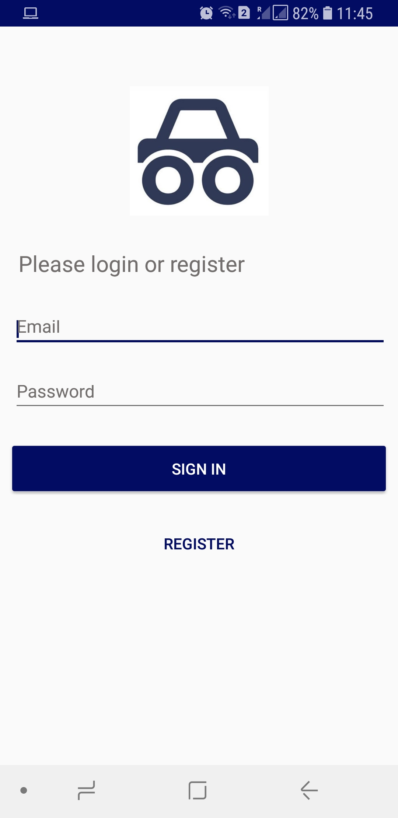
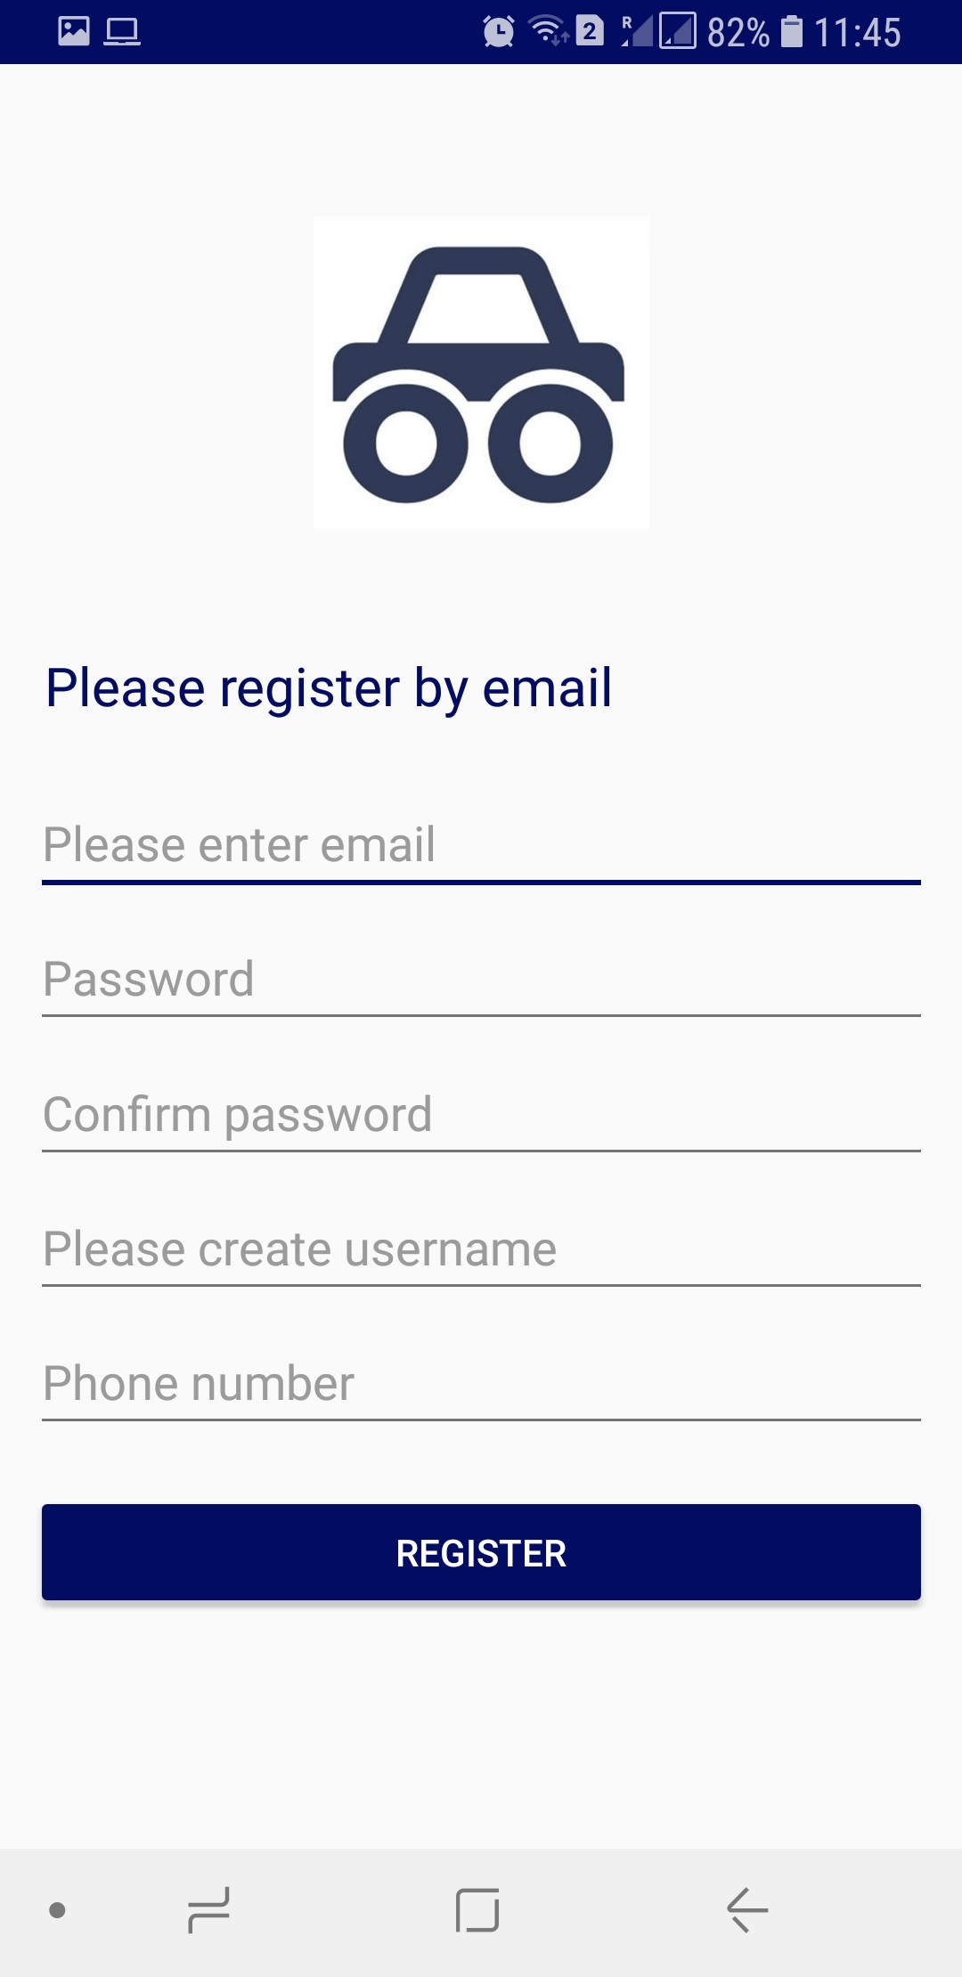
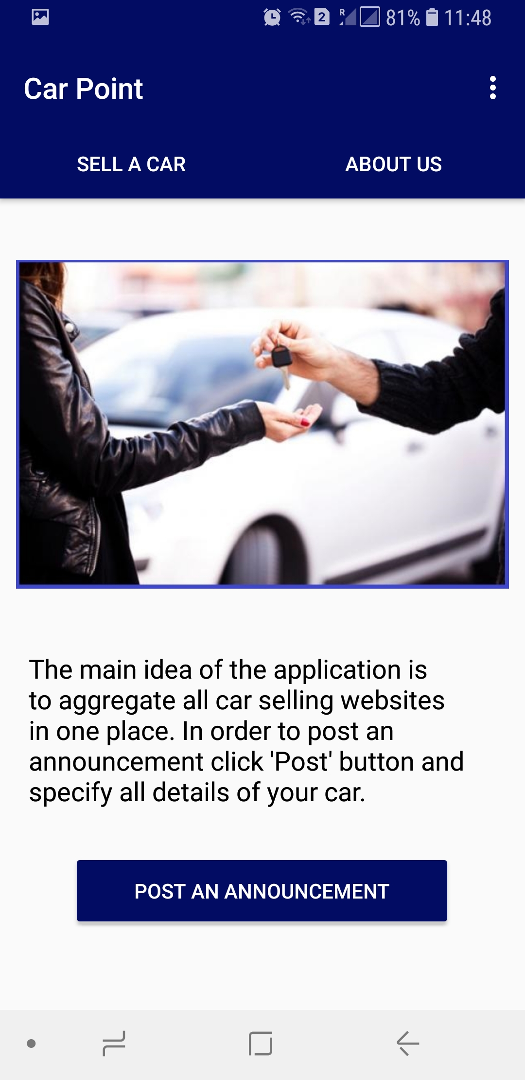

Mobile application
Simple authentication by email
Tab menu and one more menu in toolbar

Slide 6
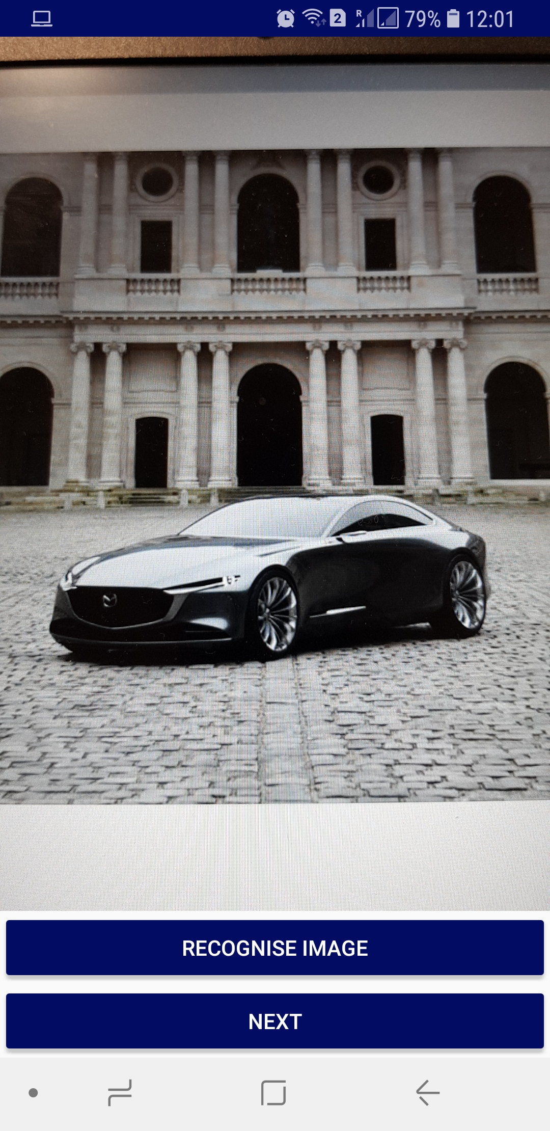
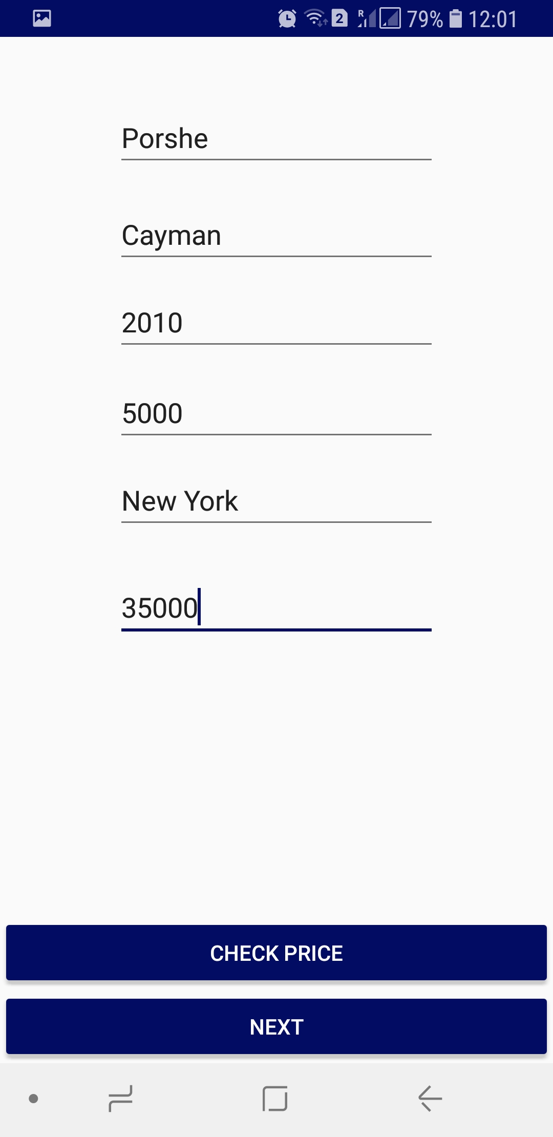
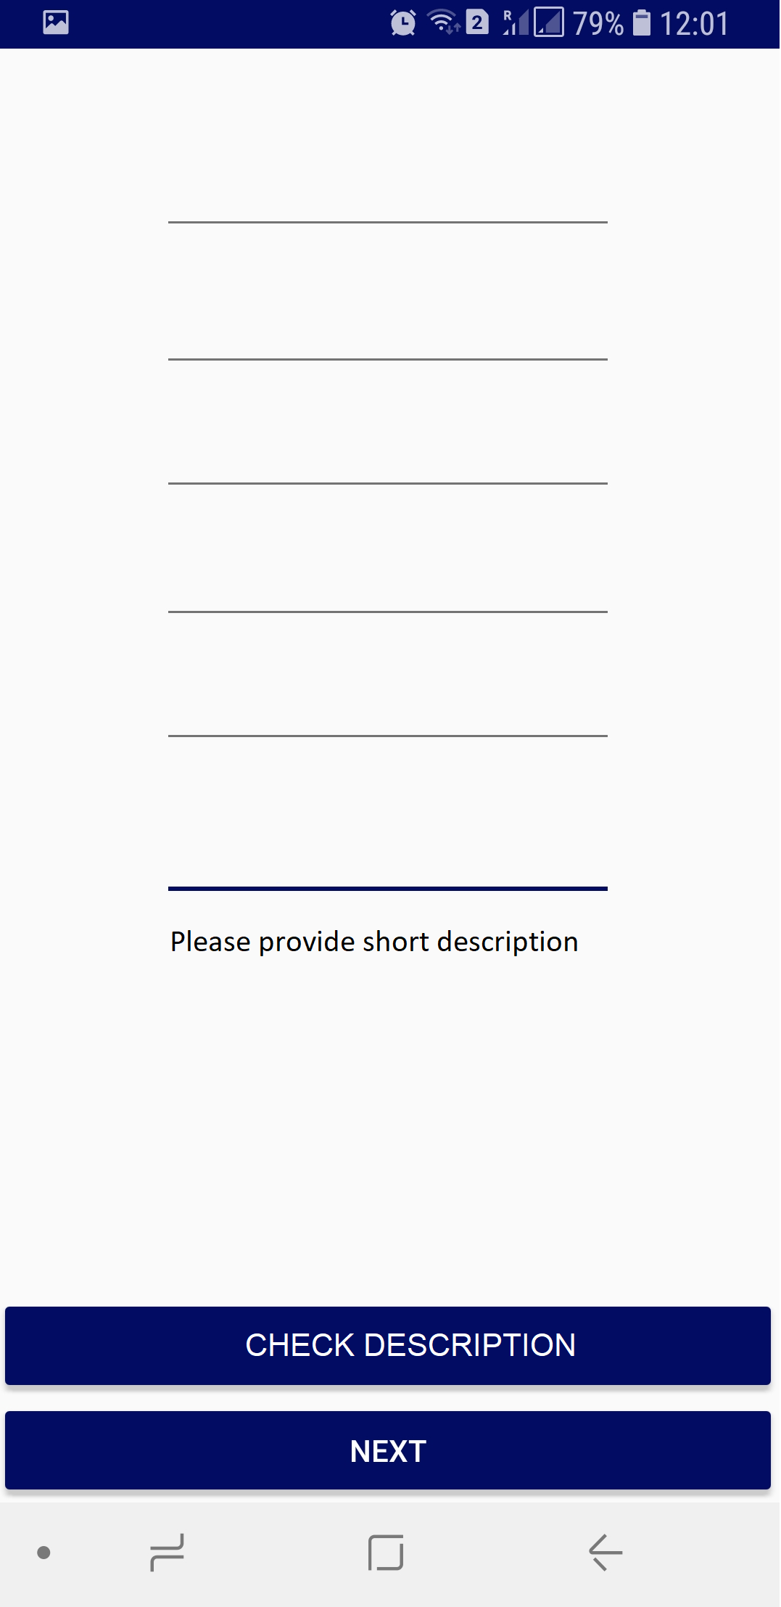
One by one (Image Recognition first)
Image Labeling
Price Prediction
Description analysis

Slide 7
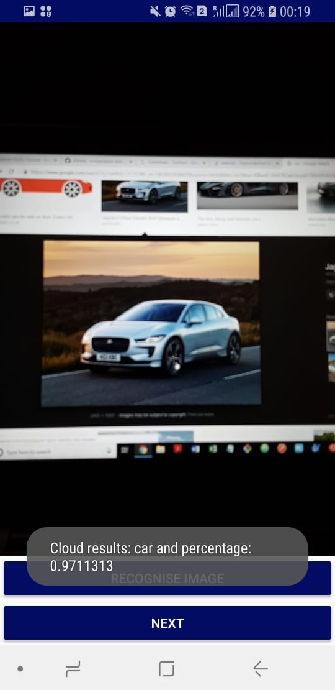
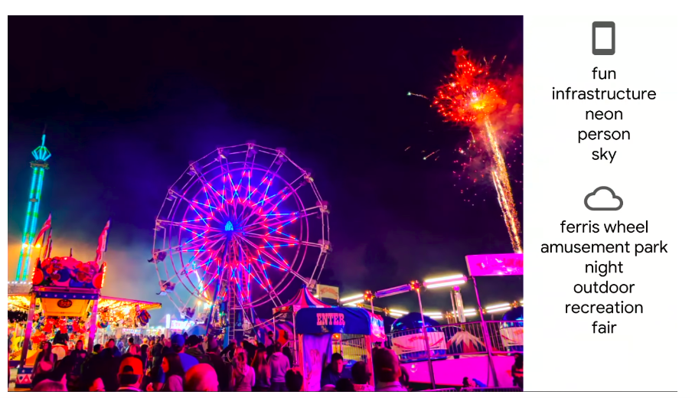
Image Labeling
ML Kit - Google's ML technologies, such as the Google Cloud Vision API, Mobile Vision, and TensorFlow Lite, together in a single SDK.

Slide 8
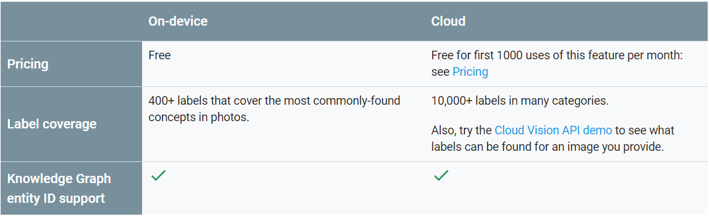
Image Labeling

Slide 9
One by one (Price Prediction second)
Image Labeling
Price Prediction
Description analysis

Slide 10
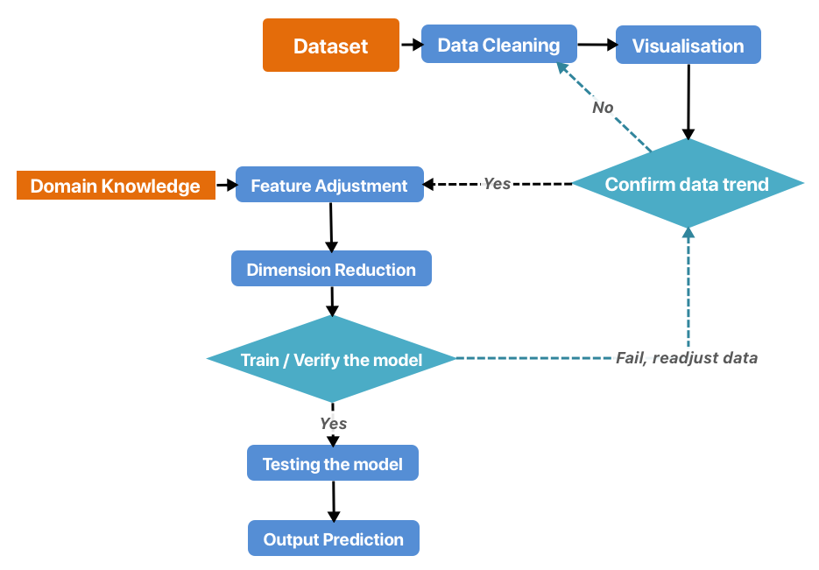
Processing flowchart

Slide 11
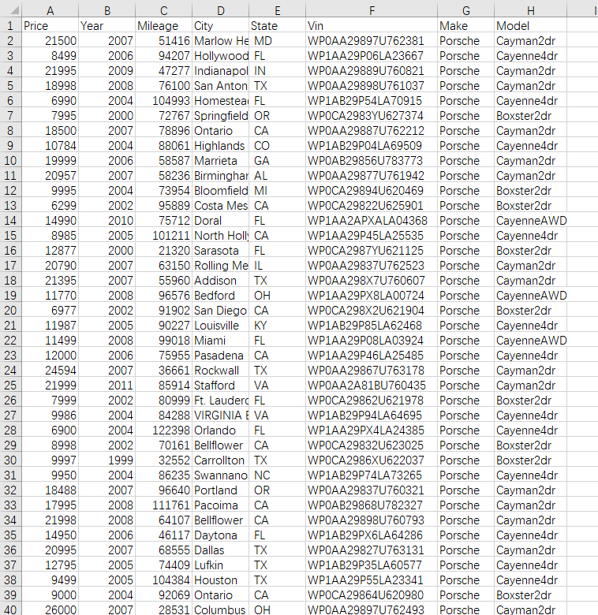
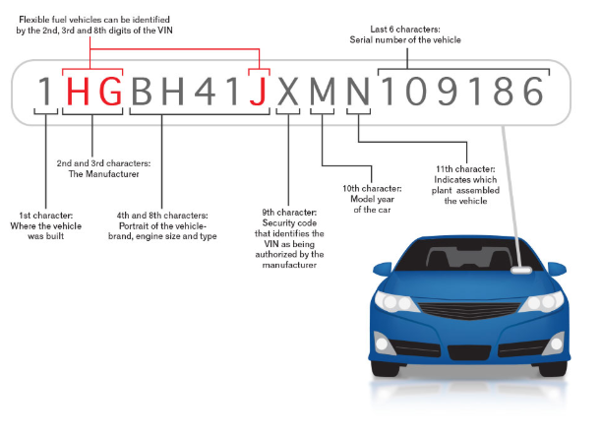
Data cleaning and Feature engineering
VIN (Vehicle Identification Number)

Slide 12
Dimension Reduction
Unify data scale & make preparations for PCA
Ensure every feature is equally important for model
Standardization
Whitening: Transform features to be orthogonal to each other
Dimension reduction: Extract important features for the model
PCA

Slide 13
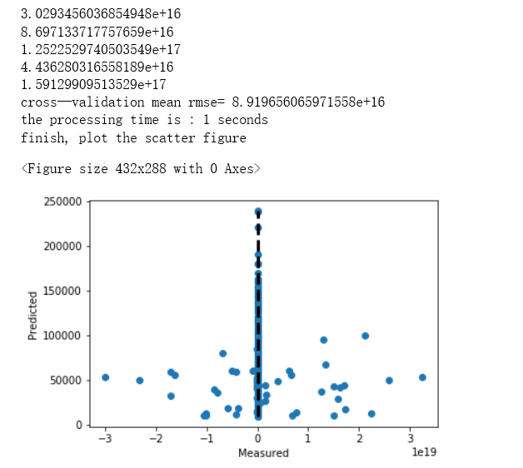
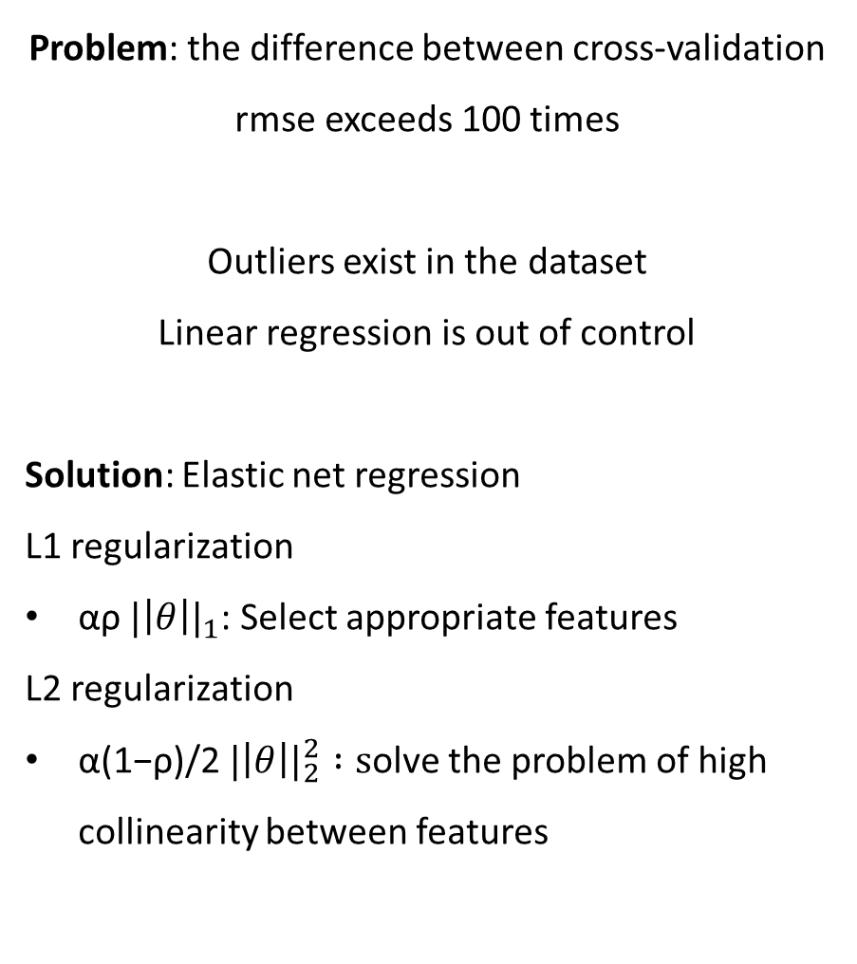
Validation set results
Problem: the difference between cross-validation rmse exceeds 100 times
Outliers exist in the dataset
Linear regression is out of control
Solution: Elastic net regression
L1 regularization
αρ ${|\left|θ\right||}_{1}$: Select appropriate features
L2 regularization
α(1−ρ)/2 ${|\left|θ\right||}_{2}^{2} :s$olve the problem of high collinearity between features
Linear regression

Slide 14
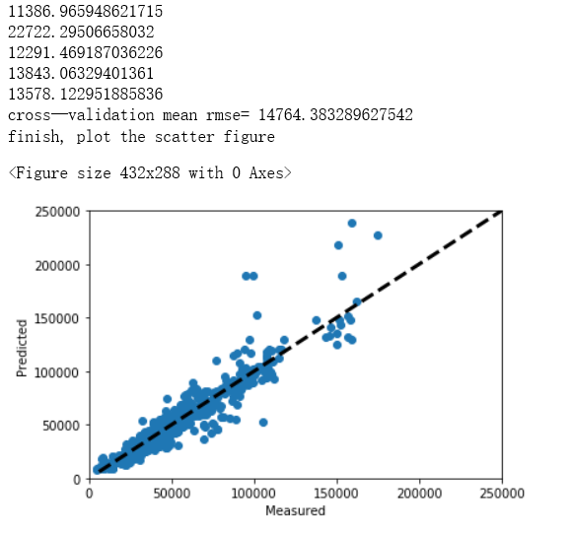
Validation set results
Elastic net regression
Hyper-parameter selection:
GridSearch
Result analysis:
Smaller RMSE
Difference between cross-validation RMSE approach to stable
More accurate prediction result

Slide 15

Our DNN Structure is different !
Efficiency
Accuracy
Rule of Thumb:
Model Complexity↑
→ Overfitting
→ Regularization
ReLU
Reference:
Geoffrey E. Hinton tutorial, 2012
How many hidden layers and nodes?, 2009 ,
Practical Recommendations for Gradient-Based Training of Deep Architectures, 2012

Slide 16
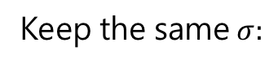
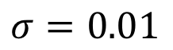
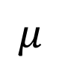
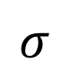
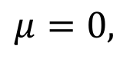
Structure
Testing
Moving Average Update
$$σ$$
$$μ$$
Input
Dropout
BN
ReLU
Hidden
Hidden
Output
W
bias
Weight Initialization:
LR = 0.1, Optimizer = AdamOptimizer
epochs = 200, batch size = 256
Neuron= 600,512,450,400,350,300,256,200,128,100,64,32,8
dropout = 0.2, Layer Count=15
Keep the same$σ:$
Weight Initialization:
Avoid Symmetric Breaking:
$$μ=0,$$
$$σ=0.01$$
GridSearch

Slide 17
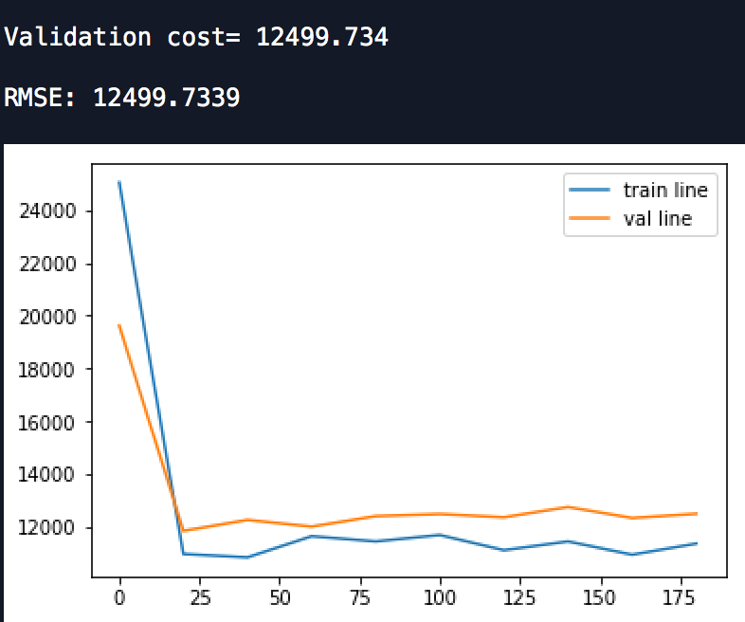
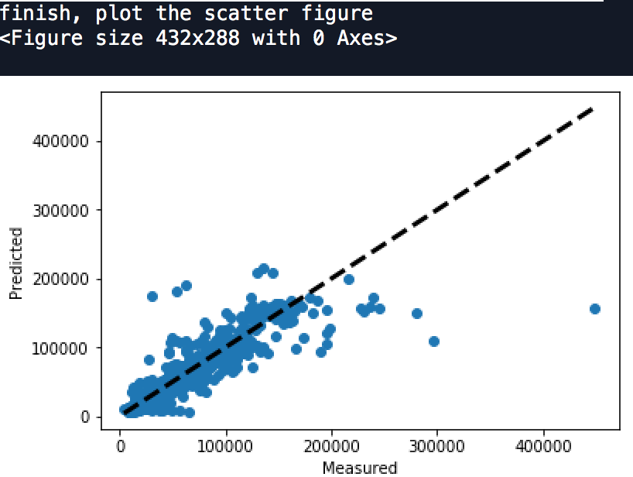
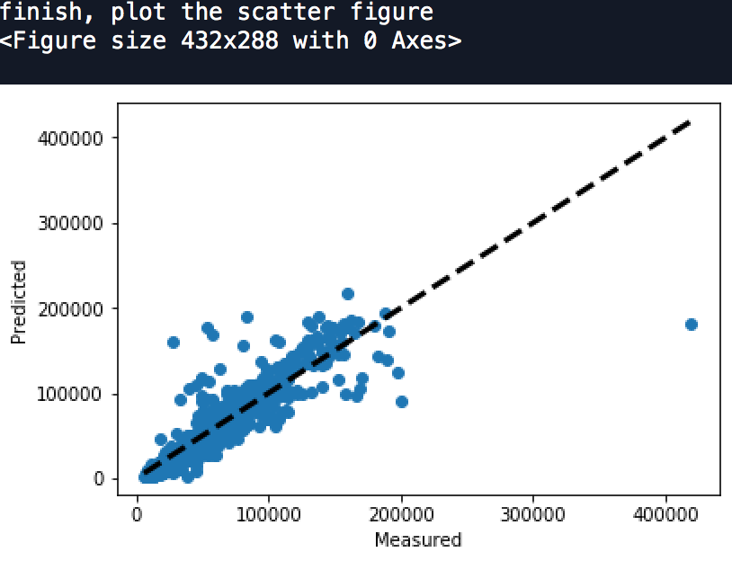
Result of Validation Set
Output
Dropout = 0.2
Early Stopping X

Slide 18
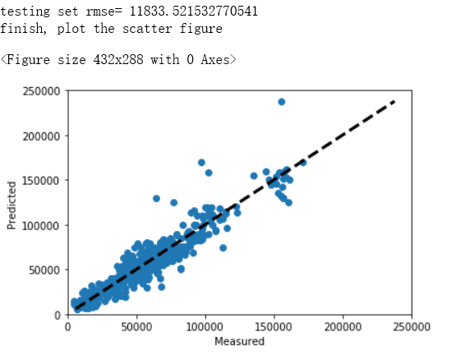
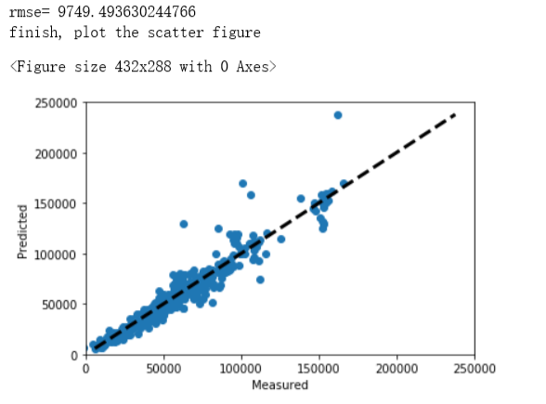
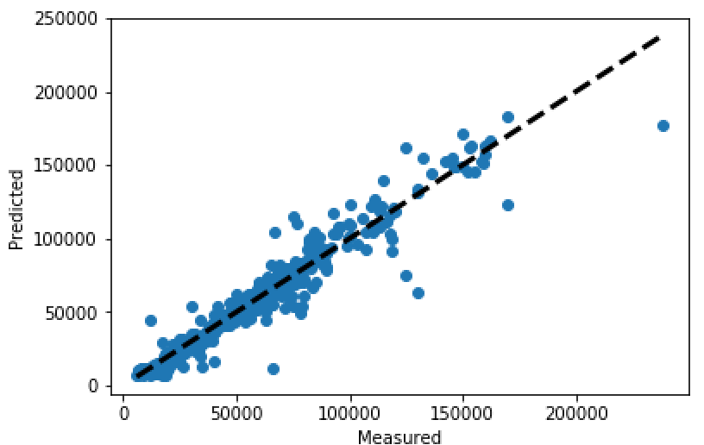
Comparison
 | Pros | Cons | Application | Testing Set Result (0~250000) | RMSE | Training Time | Testing Time
Linear | Efficiency | inaccurate | NA |  | 11833.5 | 1s | 0.1s
Elastic Net | Feature Selection (Regularization) Solve High Collinearity | Need to re-train for every time Cannot Easily Avoid Outlier | Small Data App |  | 9749.1 | 401s | 15s
DNN | Don't need to retrain Easily avoid outliers & overfitting | Expensive | Big data App |  | 9391.8 | 1758s | 13s

Slide 19
One by one (Description analysis third)
Image Labeling
Price Prediction
Description analysis

Slide 20
from Natural Language Processing (NLP) import Latent Dirichlet Allocation (LDA)
Description Box
1
2
3
4
5
6
7
8
9
10
# Step 1: User Input
# Step 2:
Text Processing
# Step 3:
Bag of Words
# Step 4: LDA
# Step 5: Return
Input ()
#Minimum 200 words description of car
from NLTK import
#Tokeniser
#Stopwords
#Stemming
from gensim import corpora
#Convert text into a matrix of words
import gensim
#Topic Modeling
if any ()
#Create a car dictionary
#If appears, print (“”)

Slide 21
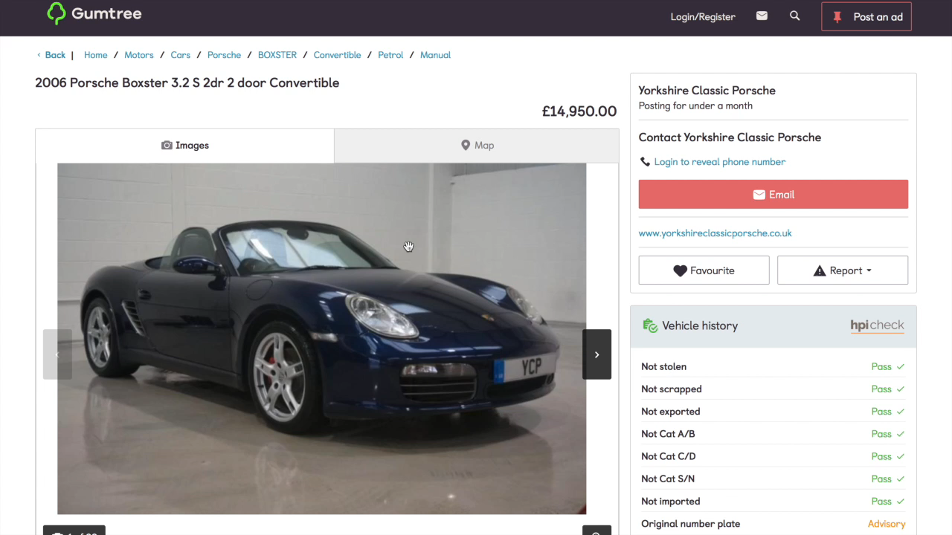

Slide 22
Thank you for your attention. Demo?

Slide 23
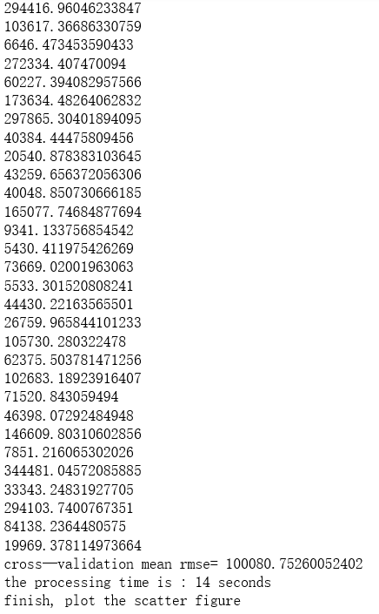
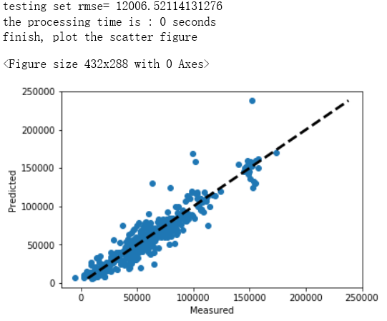
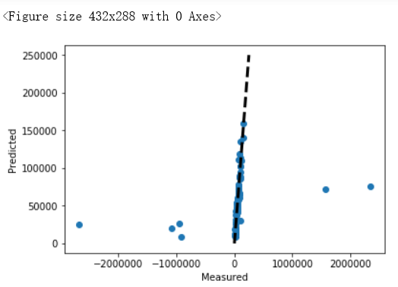
Appendix
Validation set result of linear regression (Kfold K=30)
Testing set result of linear regression

